Slide 1
529 Advanced Data Analytics
October 25, 2016
Analysis of Aircraft Accidents
T V N B Suryanarayana,
#A20191735-03

Slide 2
Table of Content
Business Scenario
Business Objective
Selected Data
Data Processing Steps
Project Plan/Data Activities
Exploratory Data Analysis Results
Regression Modeling Results
Summary/Conclusions

Slide 3
Business Scenario: Analysis of Aircraft Accidents
The dataset is about Aircraft accidents throughout the world from 1908 to August 2016. The database of accidents has both known and unknown causes.
Data chosen for analysis is between the years 2000 to August 2016 totaling to 830 observations.
The Aircraft involved in the accidents are Planes of various types as well as Helicopters and which have one or more passengers (including crew).
Military, Civilian and Private Aircraft and helicopters were included in the analysis.
The data obtained from the website contains a summary attribute indicating brief reason(s) for the accident along with other fields.
The raw data contained the following fields:
Time, Date, Summary, Operator, Location, Flight No, Route, Type (of Aircraft), Registration, CN_IN, Aboard, Fatalities, Ground, Operator.

Slide 4
Business Objective: Analysis of Aircraft Accidents
On what factors is the fatality count determined in an Aircraft accident?
The intuitive expectation is that the Number of Fatalities are dependent on the following Predictor variables
TIME, the time of the Accident
CAT_ID - CATEGORY OF ERROR COMMITTED
MONTH - MONTH OF ACCIDENT
CN_IN - Construction id of each Aircraft
TIMING - Phase of flight at which time the Error started to manifest culminating in the accident.
ABOARD – Number of Passengers and crew on the plane.
GROUND – Number of ground fatalities due to the accident.
OPERATOR – The Operator of the Aircraft .
The goal is to find a Multi variable regression model which links the Fatality number as Response variable to some or all of the Predictor variables above.

Slide 5
Selected Data: Analysis of Aircraft Accidents
This data-sets sourced are taken from :
https://www.kaggle.com/saurograndi/airplane-crashes-since-1908 and
http://www.planecrashinfo.com/
The data from the first website contains data from 1908 to 2009 while the second one has data from 1960 to 2016 (30th August).
Data from the second source above was scraped from the website and is amalgamated with the first set to give a unified data set.
Data cleaning was then performed on this dataset by eliminating characters other than those in the ASCII code and other NULL values.

Slide 6
Data Processing Steps: Analysis of Aircraft Accidents
Following attributes are not used in the modeling owing to incomplete information :
ROUTE
REGISTRATION
Following additional fields were added to the original dataset for analysis:
CAT_ID (indicative of the primary reason the accident happened) – derived from the original Summary attribute after carefully analyzing the Summary description for each Accident. Where there were multiple causes indicated in the Summary field, the most prominent cause that started the issue was considered for Categorization.
TIMING (at which phase of the flight did the accident happen)
Following are the Major classification or Categorization of causes (CAT_ID) for Accidents:
PILOT ERROR
MECHANICAL
WEATHER
SABOTAGE
OTHER

Slide 7
Data Processing Steps contd.,: Analysis of Aircraft Accidents
Following are the sub classifications which are categorized into the above Major classifications of causes for Accidents (CAT_ID):
PILOT ERROR:
Improper procedure ,Flying VFR into IFR conditions, Controlled flight into terrain ,Descending below minima, Spatial disorientation, Premature descent, Excessive landing speed, Missed runway, Fuel starvation , Navigation error, Wrong runway takeoff/landing , Midair collision caused by both pilots.
MECHANICAL:
Engine failure, Equipment failure, Structural failure, Design flaw, Maintenance error
WEATHER
Severe turbulence, Wind shear, Mountain wave, Poor visibility, Heave rain , Severe winds, Icing, Thunderstorms, Lightning strike
SABOTAGE
Hijacking, Shot down, Explosive device aboard
OTHER
ATC error, Ground crew error, Overloaded, Improperly loaded cargo, Bird strike, Fuel contamination, Pilot incapacitation, Obstruction on runway, Midair collision caused by other plane, Fire/smoke in flight

Slide 8
Data Processing Steps contd.,: Analysis of Aircraft Accidents
An additional Attribute - TIMING was also deduced from the Summary field of the original dataset. This field or Attribute describes the Phase of flight during which time the problem is triggered leading to a cascade of events and culminating in the accident. TIMING consists of the following nominal values:
IN AIRPORT - while the Aircraft is standstill or is taxiing in the Airport.
TAKE OFF - while the Aircraft is taking off from the Airport.
AFTER TAKING OFF - After the Aircraft took off and is climbing to a stable course.
MIDWAY - while the Aircraft is in flight midway between the start and finish
DURING DESCENT - while the Aircraft is descending with an intention to land.
LANDING - while the Aircraft is attempting to land.

Slide 9
Project Plan/ Data Activities: Analysis of Aircraft Accidents
The Number of Variables in the dataset are as follows:
FATALITIES – Analysis Variable – Continuous or Numeric. This variable is the Sum of Passenger and Crew fatalities recorded in any accident.
GROUND – Continuous - This is the number of personnel on the Ground who have succumbed in the accident.
CAT_ID – Predictor – Categorical Nominal – Categories of Major errors made at all levels leading to the Accident/
TIMING – Predictor – Categorical Nominal – The phase of the flight is in when the condition started manifesting leading to the Accident.
TIME – Predictor – Continuous or Numeric – The time of the accident recorded on a 24 hour scale/
DATE - Predictor – Continuous or Numeric – The date the Accident took place.
MONTH- Predictor – Nominal – The month the accident took place which is derived variable from the above date.
YEAR- Predictor – Nominal – The year in which the accident took place derived from the Accident date.
ABOARD - Predictor – Continuous or Numeric – The total number of Passengers and Crew aboard the Aircraft.
CN_IN – Predictor – Nominal – Construction ID of each Aircraft.
OPERATOR – Nominal - The operator of the Aircraft.

Slide 10
Project Plan/ Data Activities: Analysis of Aircraft Accidents
The Predictor Variables used for modeling are as follows:
TIME – Predictor – Continuous or Numeric
CAT_ID – Predictor – Categorical
CN_IN – Predictor – Categorical Nominal
TIMING – Predictor – Categorical
MONTH- Predictor – Continuous or Numeric.
ABOARD - Predictor – Continuous or Numeric
GROUND – Number of ground fatalities due to the accident.
OPERATOR – Predictor - Categorical Nominal
First using PROC FREQ and PROC SGSCATTER, the relationships between various variables are explored and then using PROC CORR the association between the Continuous variables is checked.
Then using PROC GLM the model is developed between the related continuous and categorical variables and goodness of fit is verified.

Slide 11
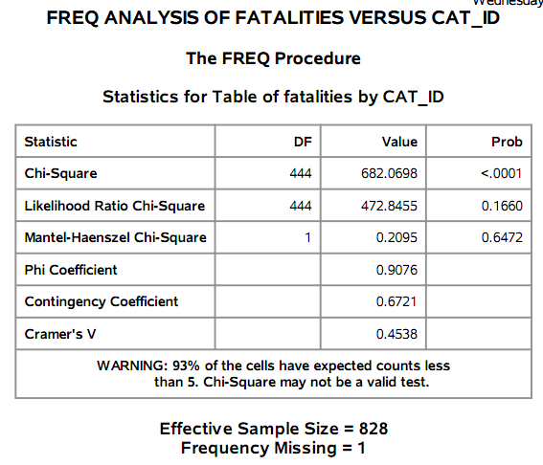
Exploratory Data Analysis Results: Analysis of Aircraft Accidents
Running PROC FREQ between Fatalities and CAT_ID with Chi-Square test shows a ‘p’ value <0.001 and hence a possible association.

Slide 12
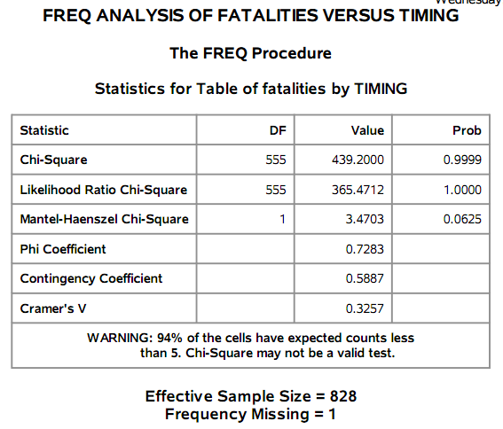
Exploratory Data Analysis Results: Analysis of Aircraft Accidents
Running PROC FREQ between Fatalities and TIMING with Chi-Square test shows a ‘p’ value which is > 0.05 and hence no association.

Slide 13
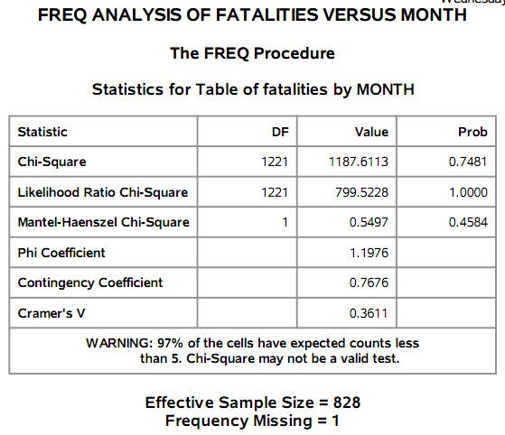
Exploratory Data Analysis Results: Analysis of Aircraft Accidents
Running PROC FREQ between Fatalities and MONTH with Chi-Square test shows a ‘p’ value which is > 0.05 and hence no association.

Slide 14
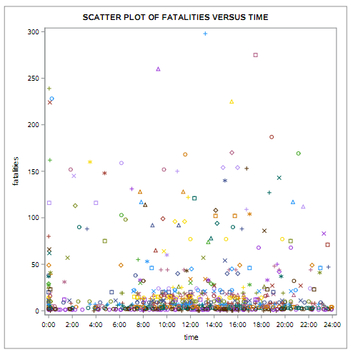
Exploratory Data Analysis Results: Analysis of Aircraft Accidents
Scatter Plot between Fatalities and Time show no clear relation.

Slide 15
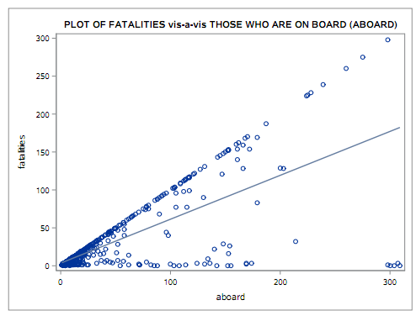
Exploratory Data Analysis Results: Analysis of Aircraft Accidents
Scatter Plot between Fatalities and those on board (ABOARD) shows an overall linear trend with a few outliers when lower values of Passengers and Crew.
The Scatter plot also shows the Regression line between FATALITIES and ABOARD.

Slide 16
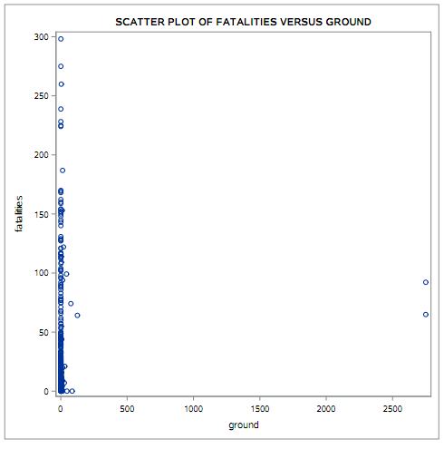
Exploratory Data Analysis Results: Analysis of Aircraft Accidents
Scatter Plot between Fatalities and those who died on Ground does not show any relationship whatsoever with only two outliers (September 11th 2001, The Twin Towers Sabotage Accidents in New York).

Slide 17
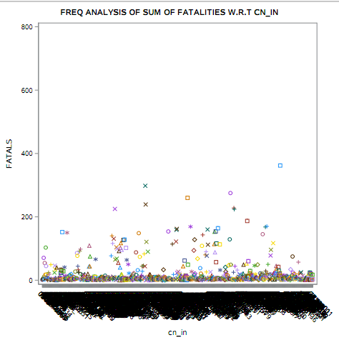
Exploratory Data Analysis Results: Analysis of Aircraft Accidents
Scatter Plot between Fatalities and CN_IN does not show any tell tale relationship which is to be further checked due to number of variables being large ( 730).

Slide 18
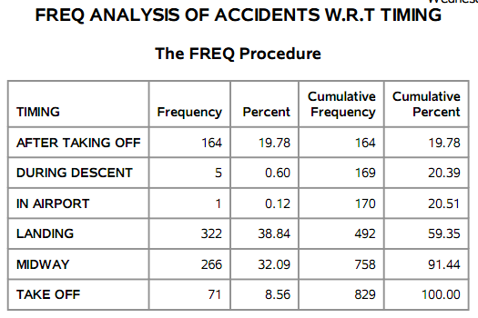
Exploratory Data Analysis Results: Analysis of Aircraft Accidents
Running PROC FREQ between Accidents and TIMING shows the percent distribution of various Accidents versus TIMING.

Slide 19
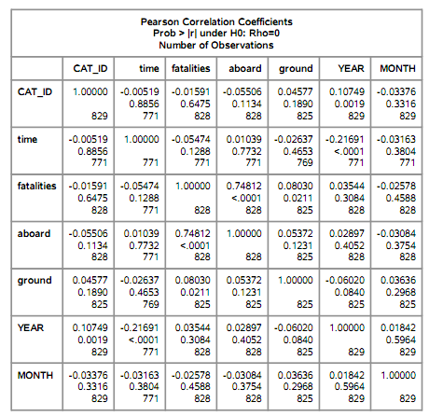
Exploratory Data Analysis Results: Analysis of Aircraft Accidents
A PROC CORR is run between the various variables and the results are shown in the adjacent figure which show that association exists ONLY between FATALITIES and ABOARD with R= 0.74812
The remaining Predictors do not have significant Pearson coefficients to indicate an association between the Response and Predictors.
In general a R value between 0.7 to 1 in either directions is considered a strong correlation while between 0.3 to 0.7 is weak correlation.

Slide 20
Exploratory Data Analysis Results: Analysis of Aircraft Accidents
The relationship between FATALITIES and OPERATOR predictor variable is not shown in this presentation as the same is not lending itself to computation owing to the large number of Operators.
After observing the Exploratory Data Analysis, it can be deduced that FATALITIES has a strong relationship with :
ABOARD and possibly with
CN_IN
However the modeling is run in three steps to further check and verify whether anything is missed between FATALITIES and all possible variables.
The third step is only between FATALITIES and ABOARD, CN_IN.

Slide 21
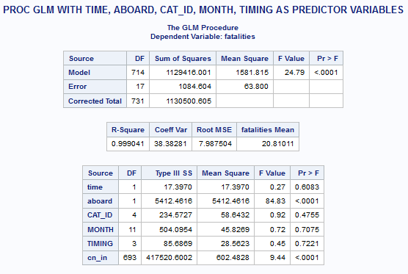
Regression Modeling Results Analysis of Aircraft Accidents- Model
Since the Predictors are both Continuous and Categorical in nature, PROC GLM is used for building the final model.
Various iterations are used for getting a best fit model between the Response variable and Predictor variables.
Initial analysis of running PROC GLM with Predictor variables – TIME, ABOARD, CAT_ID, TIMING, MONTH, YEAR, CN_IN show the results in the figure shown.

Slide 22
Regression Modeling Results Analysis of Aircraft Accidents- Model
It can be seen from the Parameter estimates that only the following variables void the null hypothesis and hence can be considered in the final model with ‘p’ values < 0.0001:
ABOARD
CN_IN
The Adj. R squared with the above variables is 0.9587 which means that the model explains 95.87 % of the actual values.
On eliminating the variables which do not effect the Response variable, the model is again run a second time with only ABOARD and CN_IN as predictor variables:
TITLE 'PROC GLM WITH ABOARD, CN_IN AS PREDICTOR VARIABLES';
PROC GLM DATA=ITMD529.AIR_SUBSET PLOTS=DIAGNOSTICS;
CLASS CN_IN ;
MODEL FATALITIES= ABOARD CN_IN /SOLUTION SS3;
RUN;

Slide 23
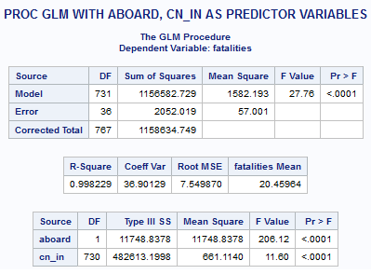
Regression Modeling Results Analysis of Aircraft Accidents- Model
The Model results are shown in the adjacent figure:
The overall model ‘P’ value is < 0.0001 indicating a fit with an overall ‘F” value of 27.76.

Slide 24
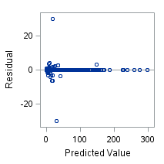
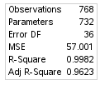
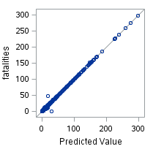
Regression Modeling Results Analysis of Aircraft Accidents- Model
It can be seen from the Fit diagnostics in the figure that the Residuals are mostly centered around the mean i.e., have the same spread except for two outliers above and below the x-axis.
The Adj. R square with the above variables is 0.9587 which means that the model explains 95.87 % of the actual values and the line fits well.

Slide 25
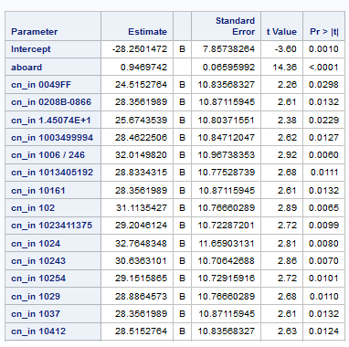
Regression Modeling Results Analysis of Aircraft Accidents- Model
The Parameter estimates are shown in the adjacent figure with only a few CN_IN’s in the same as the DF is 730 (actual number of values -1).

Slide 26
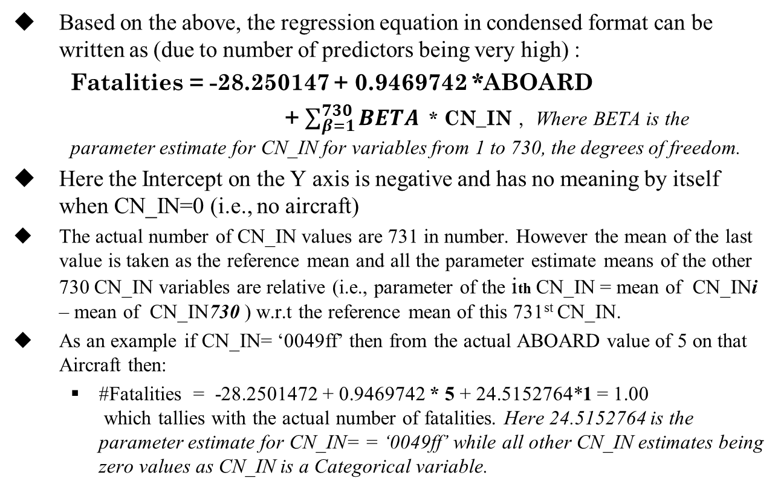
Regression Modeling Results Analysis of Aircraft Accidents -Model
Based on the above, the regression equation in condensed format can be written as (due to number of predictors being very high) :
Fatalities = -28.250147 + 0.9469742 *ABOARD
+ $\sum_{β=1}^{730}{BETA}$ * CN_IN , Where BETA is the parameter estimate for CN_IN for variables from 1 to 730, the degrees of freedom.
Here the Intercept on the Y axis is negative and has no meaning by itself when CN_IN=0 (i.e., no aircraft)
The actual number of CN_IN values are 731 in number. However the mean of the last value is taken as the reference mean and all the parameter estimate means of the other 730 CN_IN variables are relative (i.e., parameter of the ith CN_IN = mean of CN_INi – mean of CN_IN730 ) w.r.t the reference mean of this 731st CN_IN.
As an example if CN_IN= ‘0049ff’ then from the actual ABOARD value of 5 on that Aircraft then:
#Fatalities = -28.2501472 + 0.9469742 * 5 + 24.5152764*1 = 1.00 which tallies with the actual number of fatalities. Here 24.5152764 is the parameter estimate for CN_IN= = ‘0049ff’ while all other CN_IN estimates being zero values as CN_IN is a Categorical variable.

Slide 27
Summary/Conclusions: Analysis of Aircraft Accidents
The Number of Fatalities (Severity) is predominantly explained by those on board (ABOARD) and the CN_IN the construction number of the Aircraft for the given dataset. Other variables like TIME, TIMING, CAT_ID, MONTH, YEAR, and OPERATOR are not significant in being able to explain the fatality numbers.
However when individually analyzed, the Category of Errors (CAT_ID) in terms of severity of accident (fatality numbers) in descending order :
PILOT ERROR
WEATHER
MECHANICAL
SABOTAGE
OTHER
Similarly the phases of flight (TIMING) which prove the most dangerous in terms of causing the most deaths in descending order of severity:
LANDING
MIDWAY
AFTER TAKING OFF
TAKE OFF
DURING DESCENT

Slide 28
Analysis of Aircraft Accidents
Thank You

